Slide 1
Chapter 1: Introduction (OS Types, Modes, Structure, and Services)

Slide 2


Think
Identify!!

Slide 3
Contents
01
03
05
Introduction to Operating Systems
Types of Operating Systems
Operating System Operations
02
04
06
Computer System Structure
Advanced Operating Systems
Operating System Services

Slide 4

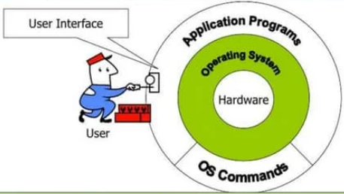

Operating System?
Layer of System Software
Role as an Interface
Resource Management
Abstracts the complexities of the underlying hardware
Acts as an intermediary between users and the computer hardware
Allocates and de-allocates resources to applications

Slide 5



Goals of Operating Systems
01
02
03
Execute User Programs
Convenience and Efficiency
Resource Allocation
Ensure that user programs run smoothly and efficiently.
Enhance user convenience by providing a user-friendly environment.
Balance requests from various applications

Slide 6

Components of a Computer System
Hardware
System and Application Programs
Consists of the physical devices such as the CPU, memory, and I/O devices.
Manage the hardware and provide a platform for higher-level applications.
Utilize system resources to perform specific user-directed tasks.
Role of Operating System
It acts as a manager, ensuring that all system parts operate harmoniously.

Slide 7



Batch Operating Systems
01
Characteristics
Users submit jobs without interaction, and the system executes them sequentially
02
Advantages and Disadvantages
Higher Resource Utilization
03
User Interaction Limitations
Users cannot interact directly, leading to delays in feedback.

Slide 8
Multiprogramming Operating Systems
03
02
Benefits of Multiprogramming
01
Need for CPU Scheduling
Increased CPU efficiency by minimizing idle time.
Definition and Mechanism
The system must decide which process to execute:
Priority
Resource availability
Process state
Allow multiple processes to reside in memory but only one process remains active.

Slide 9
Multitasking/Timesharing OS
Concept and Execution
Allow multiple jobs to share CPU time by rapidly switching processes.
Role of CPU Scheduling
Determining which processes gain access to the CPU based on algorithm.
Swapping Mechanism
Transfers processes between main memory and disk storage
Ensuring that the CPU always has a process to execute.

Slide 10



Multiprocessing Operating Systems
01
02
03
Definition and Functionality
Shared Memory Concept
Advantages
Coordinate tasks across processors in OS
Uses parallelism to enhance power and performance
Memory sharing enables efficient communication, exchange
Enhances system performance
Enable faster processing times
Improved fault tolerance

Slide 11
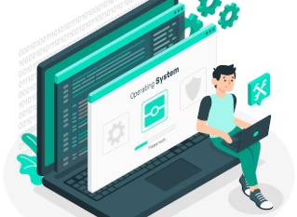

Operating System Views
User Viewpoint
System Viewpoint
Aims to maximize productivity by simplifying interactions
Emphasizes the OS's role as a resource manager and control program.

Slide 12
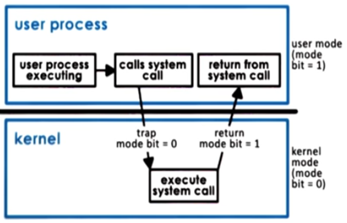
Operating Systems Operations
Operations
System Calls and Exceptions
To protect OS, Dual-mode operations exist:
User mode (1) and kernel mode (0)
A Mode bit is added to the hardware.
Programs use interrupts for services/errors.

Slide 13
Dual-Mode Operation
Transition Mechanism
Switching to kernel mode happens during
System calls or interrupts, enabling tasks
User Mode vs. Kernel Mode
User mode:
Applications operate with limited privileges
Kernel mode:
Offers full access to system resources.

Slide 14
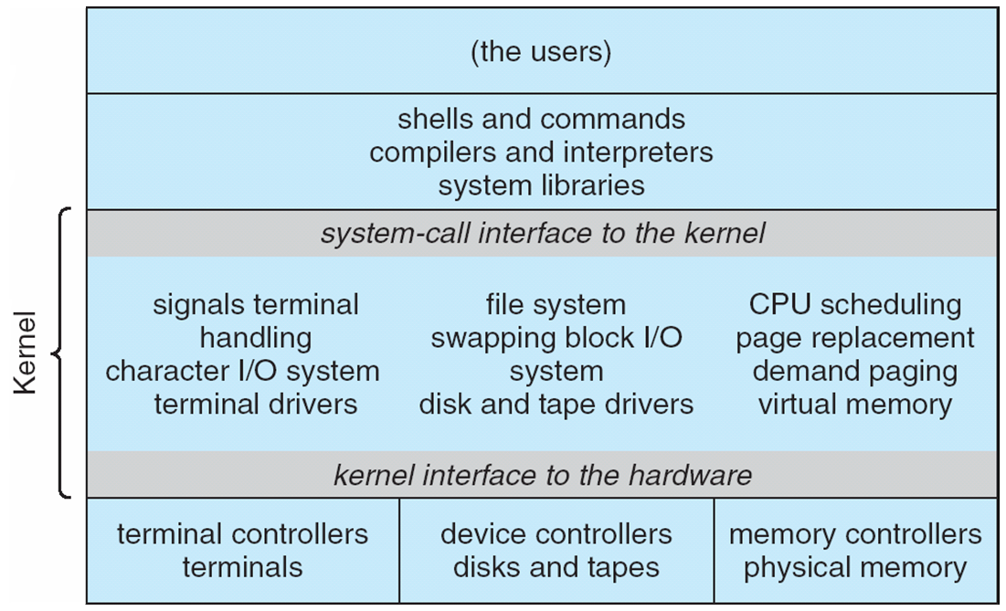
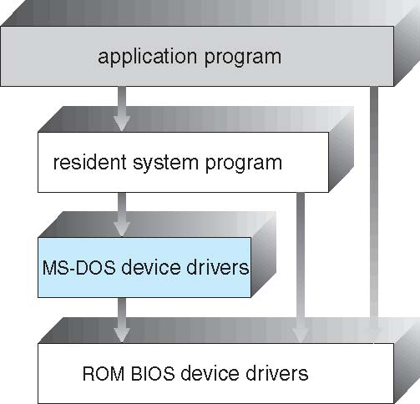
Operating Systems Structure
Simple Structure -- MS-DOS
Traditional UNIX System Structure
Provide most functionality in least space
Not divided into modules
Levels of functionality are not separated

Slide 15
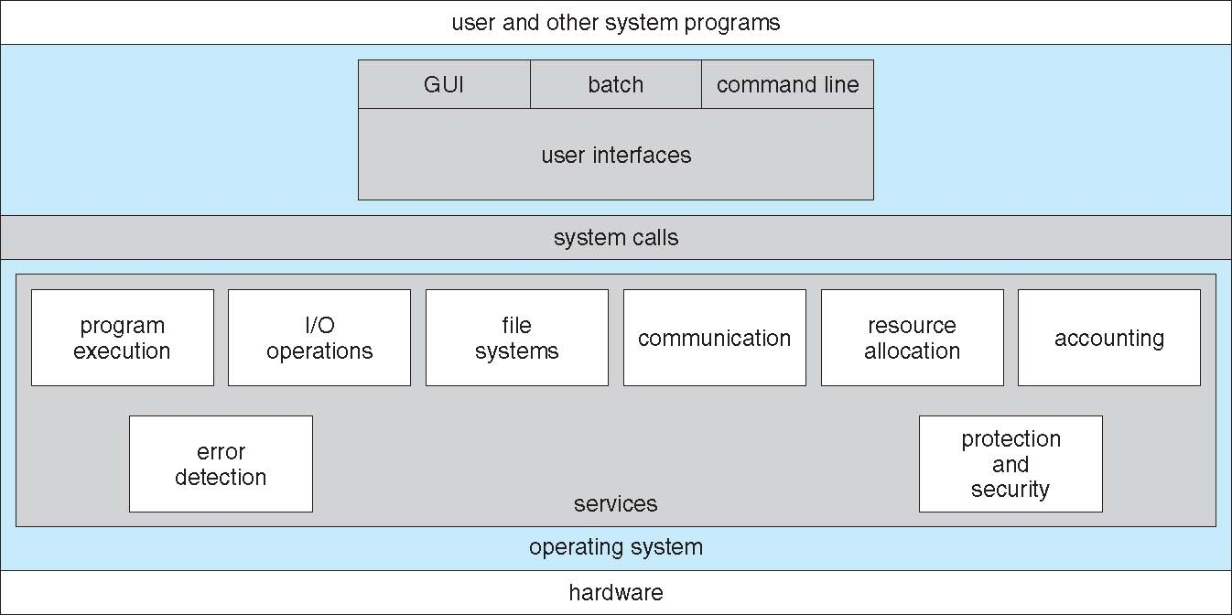
Operating Systems Operations
An operating system provides an environment for the programs to run.

Slide 16
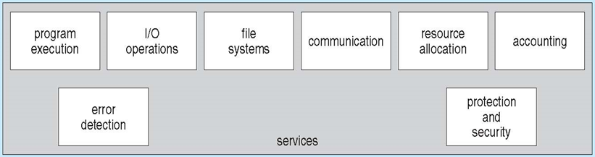
Types of Services Provided
User Interface Options
Program Execution Services
I/O Operations and File Management
Offer CLI and GUI interfaces
Loads programs and manages their lifecycle
Coordinates I/O between applications and hardware

Slide 17
Communication and Error Detection
03
Resource Management and Control
OS manages resources, priorities, and hardware
02
Constant Error Awareness
Monitors system activities for errors continuously
01
Communication Mechanisms
Enable process communication through synchronized methods

Slide 18

Practice MCQ
Link:
https://tinyurl.com/practicemcqunit1
QR Code:

Slide 19

Practice MCQ
Link FOR INTRODUCTION QUIZ1 :
QR Code:

Slide 20
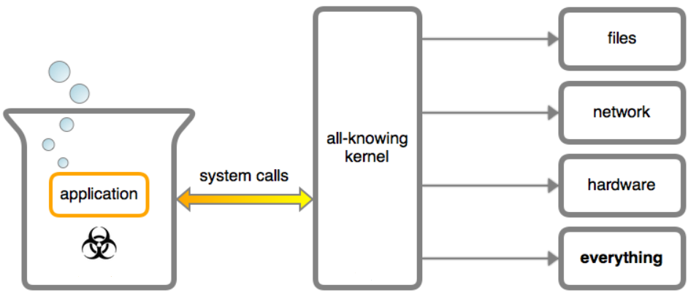
Whats Next!!

Slide 21
Whats Next!!: System Calls

